Slide 1

EDA-Capstone Project On Airbnb Booking Analysis BY: AYESHA FIRDOSE W

Slide 2
Key Points
1. Introduction
2. Problem Statements
3. Understanding Dataset
4. Columns In The Dataset
5. Overview Of the Dataset
6. Data Cleaning/Data Preparation
7. Exploratory Data Analysis
8. Key Fields
9. Conclusions

Slide 3


Airbnb
Airbnb is an American company that focuses on accommodation, primarily homestays for vacation rentals and tourism activities. Based in San Francisco, California, the platform is accessible through a website and mobile app. Airbnb does not own any of the listed properties, instead profiting from the commission income from each booking. The company was founded in 2008 by Brian Chesky, Nathan Blecharczyk and Joe Gebbia. Airbnb is a shortened version of its original name, AirBedandBreakfast.com.
The company has been criticized for enabling bait-and-switch scams, engaging in West Bank settlements, possibly raising house rents and creating inconvenience for those living near rental properties. The company is regulated by many jurisdictions, including the European Union and cities such as San Francisco and New Your City.

Slide 4
Problem Defining Statement
Since 2008, guests and hosts have used Airbnb to expand on traveling possibilities and present a more unique, personalized way of experiencing the world. Today, Airbnb became one of a kind service that is used and recognized by the whole world. Data analysis on millions of listings provided through Airbnb is a crucial factor for the company. These millions of listings generate a lot of data - data that can be analyzed and used for security, business decisions, understanding of customers' and providers' (hosts) behavior and performance on the platform, guiding marketing initiatives, implementation of innovative additional services and much more.
This dataset has around 49,000 observations in it with 16 columns and it is a mix between categorical and numeric values.
Explore and analyze the data to discover key understandings (not limited to these) such as :
What can we learn about different hosts and areas?
What can we learn from predictions? (ex: locations, prices, reviews, etc.)
Which hosts are the busiest and why?
Is there any noticeable difference of traffic among different areas and
what could be the reason for it?

Slide 5
Understanding The Dataset
A dataset is a collection of data within a database. Datasets typically have a tabular format consisting of rows and columns. Each column represents a particular variable, while each row corresponds to a particular value.
It helps data scientists check the assumptions needed to fit models. In addition to understanding the input data set, it is also important to understand the data generated during the model-building process.

Slide 6
Columns In The Dataset
'id': It is the unique ID of the property listed by a particular host.
'name': It is a column that contains the name of the listed property on Airbnb.
'host_id' & 'host_name': Many hosts offer many properties. These 'host_id' & ‘host_name’ contain records of all the hosts.
'neighbourhood' and 'neighbourhood_group': These columns contain information about the city and areas of properties offered by Airbnb New York.
'Longitude' and 'Latitude’: As the name suggests, it only contains the longitude and latitude of the location of the property.
‘room_type': Shows the room type of the property (either private room / Entire home/apt / shared room ).
'price': It is an important column that contains the price value of all these properties.
'minimum_nights': Gives us information about the minimum number of nights that hosts offer for a specific property.
'number_of_reviews' and 'reviews_month': Contains information about the number of reviews and reviews per month for these facilities and host hospitality.
'availabilty_365': Provides information about the availability of the listed property out of the total 365 days in a year.
calculated_host_listings_count- refers to the number of properties listed under a particular host.

Slide 7
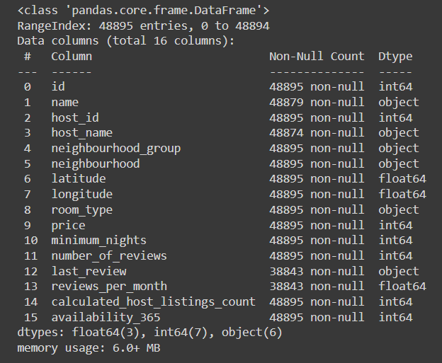
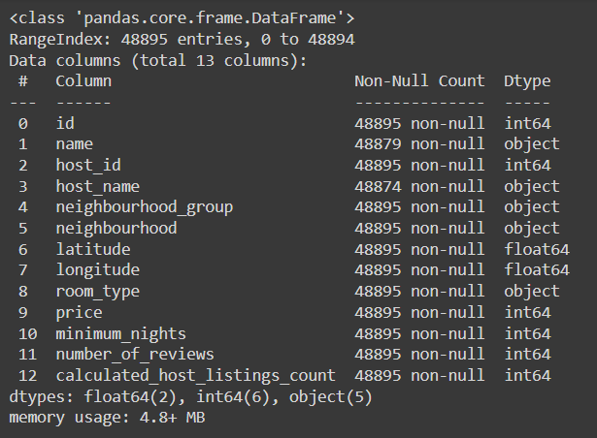
Overview of Dataset
Original Dataset Filtered Dataset
Originally as we can see we had 48895 rows and 16 columns.
As we filtered the data now we have, 48895 rows and 13 columns as 3 columns were dropped for further analysis.

Slide 8
Data Cleaning
Data cleaning is the process of fixing or removing incorrect, corrupted, incorrectly formatted, duplicate, or incomplete data within a dataset. Our cleaning process involved the following parts:
1. We observed that there were some null values present in a few of our columns:
‘last_review’: the last_review column has more than 20% of the null values and this is quite an irrelevant column for our analysis so we have simply dropped this column.
'availabilty_365': Provides information about the availability of statements, which is not needed for our analysis of the current problem statement.
‘reviews_per_month’: Provides information about reviews per month for the facilities provided by the hosts, and this data is not needed for our analysis.

Slide 9
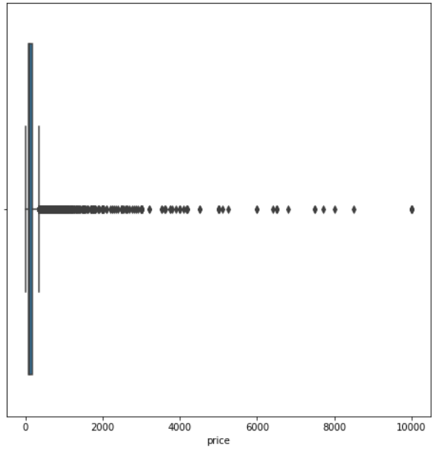
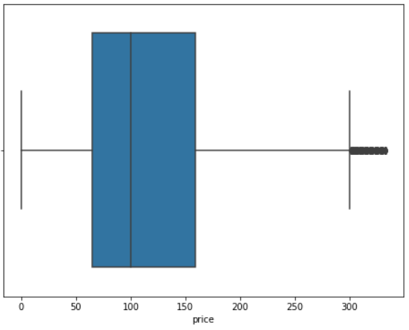
Dealing with Outliers
Outliers can have a large influence on statistics derived from the dataset. Considering whether to exclude extreme data points, sensitivity analyses with and without the identified outliers may help to determine if findings and statistical tests are appreciably altered by their presence.

Slide 10
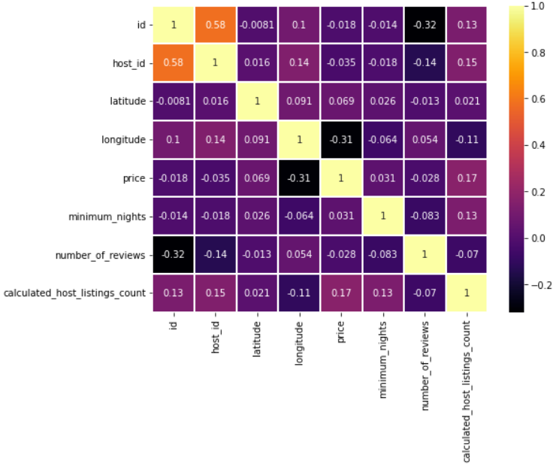
Correlation
Correlation() method in Python is used to return Pearson's correlation coefficient between two inputs.
r = The correlation coefficient. It is usually between -1 (negative correlation) and +1 (positive correlation).
x = The mean values of the x dataset.
y = The mean value of the y dataset.

Slide 11
Exploratory Data Analysis
Exploratory Data Analysis EDA is an approach to analyse the data using visual techniques. It is used to discover the patterns, trends or to check the assumptions with the help of statistical summary and graphical representations.
Why is EDA used?
EDA helps to Explore Data.
Helps to discover trends in dataset.
Visualize the data.
Understand the features and many more..

Slide 12
What can we learn about difference hosts and areas?

Slide 13
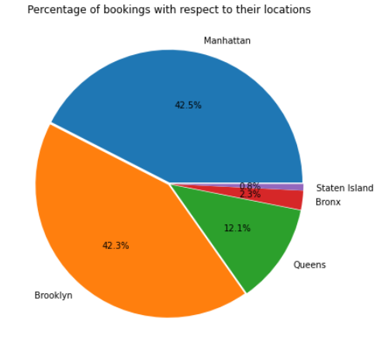
Neighbourhood Groups
Manhattan holds a record of highest number of
booking followed by Brooklyn and they
together holds around 85% of the
total booking while Staten Island holds
the least percentage of booking in the
neighborhood group.

Slide 14
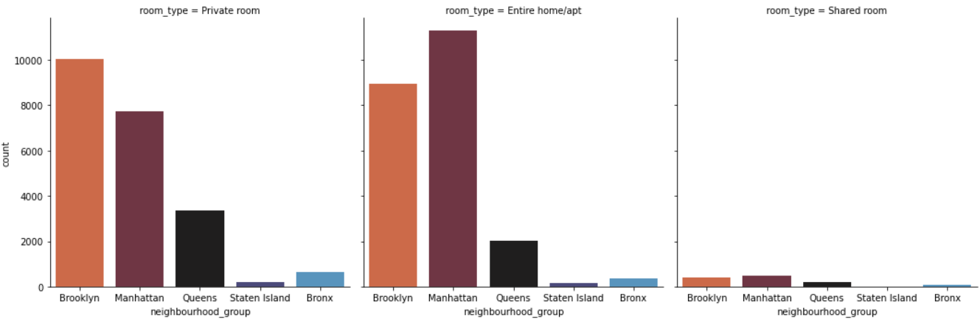
Room Type Demand In Neighbourhood Groups
With respect to all neighborhood groups, Entire/home apt room has been more preferred followed by Private room
We can clearly see Private room is more preferred in Brooklyn and Entire home/apt is more preferred in Manhattan.
The shared room is less preferred by every location.

Slide 15
What can we learn from predictions? (ex: locations, prices, reviews, etc)

Slide 16
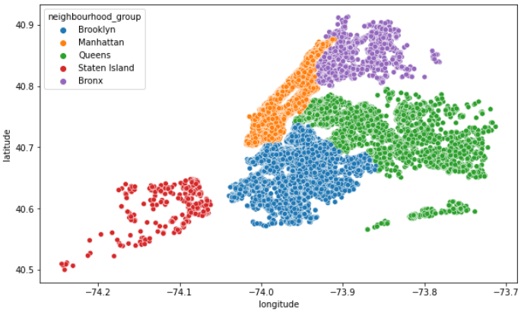
Hosts and Areas
Manhattan is the most densely populated neighborhood group by hosts and this may be due to the
presence of Manhattan island bordered by the Hudson, East, and Harlem rivers another neighborhood group.

Slide 17
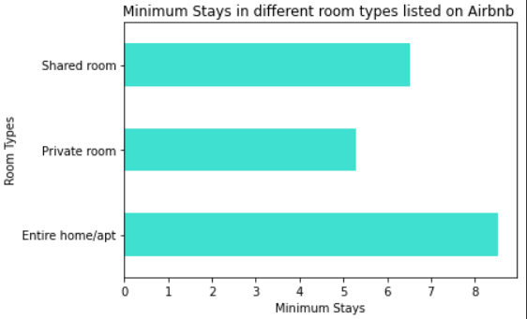
Room Types
Entire home/apt holds the highest
number of booking followed by Private
room and they together holds maximum
number of the total booking while Shared
room holds the least percentage of booking.

Slide 18
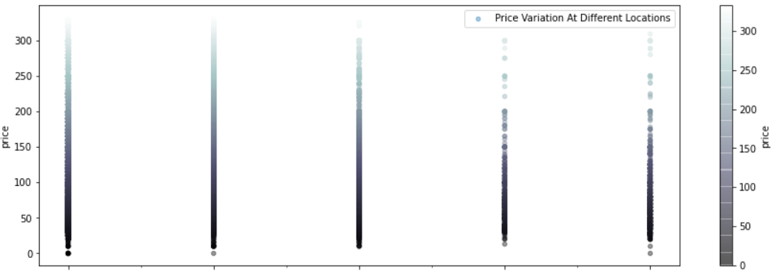
Prices with respect to Locations.
Manhattan has higher prices followed by Brooklyn,
this may be as Manhattan remains one of the world’s
most popular tourist destinations. One explanation
could be that Brooklyn can be (relatively) less
financially demanding than Manhattan.
B M Q Br SI

Slide 19
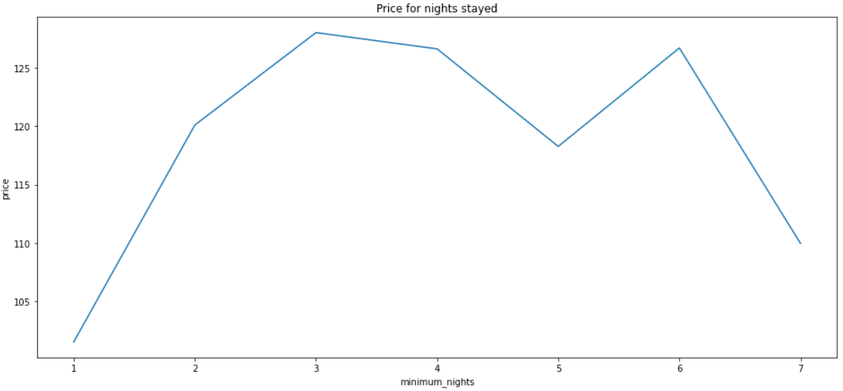
Inference: More the nights, less the price for stay. The trend from the above graph shows a week data containing 7 days, as we can observe that the prices are higher when the number of nights stayed is less than a week and decreasing gradually with the increase in days stayed.
Prices and Minimum nights

Slide 20
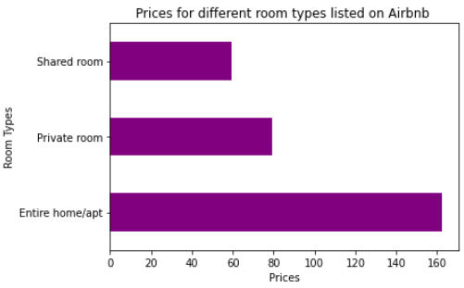
Prices for different Room Types
As we can see prices for an Entire home/apt is high as
Most of the bookings were done in the most popular
Cities like Manhattan and Brooklyn and the prices
for the shared room is quite less as it is shared with
2 or more people.

Slide 21
Which hosts are the busiest and why?

Slide 22
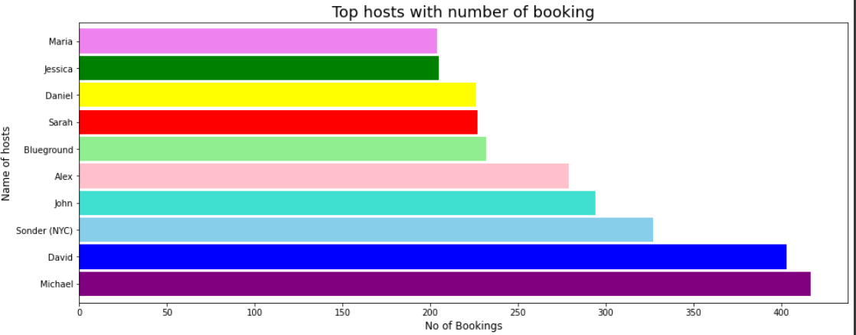
Most Busiest Host
Michael is the most the busiest host in
the Airbnb NYC dataset Busiest host
because it has the most bookings. The
the reason may be its location as it is
is located in Manhattan group and has
Whole house/apartment where demand
Is at a peak with higher the price we have
Already seen in the previous visualization.

Slide 23
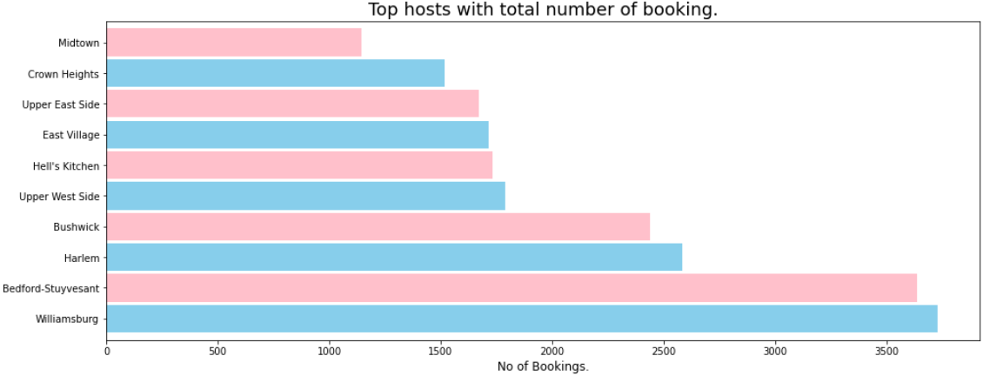
Most Demanded Neighborhoods
Williamsburg is the city with
the largest number of number bookings
in our Airbnb dataset and seven of the
ten best cities belonging from the
Brooklyn neighborhood groups, who
Prefer a private room type. Though it is
From Brooklyn neighborhood group
We may say that its popularity in NYC
Is due to its best and most famous
restaurants, bars, and shopping centers.

Slide 24
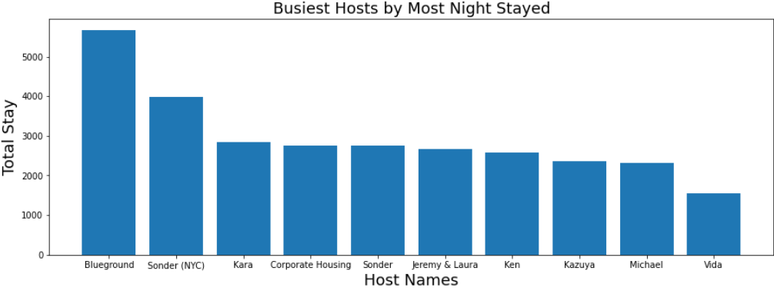
Host With Most Listing
Blueground is the host with the most listed properties on Airbnb NYC followed by Sonder(NYC). Blueground belongs from Manhattan neighborhood group and most of its listings have Entire homes/apartments.
The reason these hosts are the busiest of all is that they belong to the Manhattan neighborhood group and have the Whole House/Apt room type where demand is at its peak. higher price due to its location.

Slide 25
Is there any noticeable difference of traffic among different areas and what could be the reason for it?

Slide 26
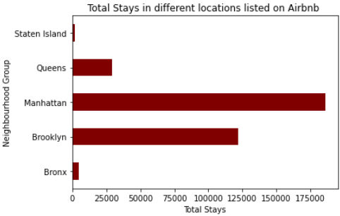
Traffic Among Areas
Inference:
As we can see total nights stayed by the customers are more in Manhattan, Brooklyn, Queens and clearly we can state that they are the most traffic observed areas as many hosts also belong to the respected neighborhood groups. The more the nights stayed more the traffic observed in these areas as we earlier saw that Manhattan is busiest group and many hosts belong to that.

Slide 27
Key Findings
Hosts from the Manhattan neighborhood have a higher number of properties listed on Airbnb.
The Manhattan and Brooklyn neighborhood groups hold 85% of the total reservation, while Staten Island has the fewest reservations observed.
Entire house/apt is the most preferred room type, followed by private room.
Queens and Staten Island have significantly fewer host listings than Manhattan. So we should take sufficient steps to support Queens and Staten Island host lists.
Total nights stayed by the customers are higher in the Manhattan group.

Slide 28
Conclusions
Finally here we come to an end of our Analysis, and we can see that Manhattan is the most highly preferred place for tourist attraction as it is highly preferred by the customers and many hosts belong to that place, the reason why Manhattan is most preferable is that it is considered as one of the world’s foremost commercial, financial, and cultural centers. So most of them prefer to stay in Manhattan
I also observed Brooklyn is the second most preferred as this area is definitely worth exploring as it’s home to iconic New York attractions like Coney Island, Brooklyn Bridge, and Prospect Park, plus some of New York’s best pizza.
Queens, Staten Island, and the Bronx are less preferred as the number of nights stayed and the hosts are also very low, it may be because the tourists attract the famous spots which are more advertised, and those are the less famous destinations

Slide 29
Conclusions
Staten Island has sometimes been called the "forgotten borough" by residents who feel neglected by the city government, tourists are attracted to coastal and island areas because they get a peaceful atmosphere and a clean and green environment there. They get the relaxation to leave their hectic schedule.
Also in the column of minimum_nights we observed that in our dataset there were 1 or 2 nights and the prices for those nights were 0, we may tell that Airbnb provides free nights to their Elite or Premium members to attract the customers so that they may prefer Airbnb to make their bookings for the next time.

Slide 30

THANK YOU

